Slide 1
Characterisation of City Districts in Amsterdam for Prospective Residents
Jojanneke

Slide 2
Finding the right place to live can be difficult in large cities
Finding the perfect place to live is dependent on multiple variables:
House size
Price
Nearby venues
Type of neighbours (e.g. age, cultural background)
Housing websites may offer information of the first two categories, but rarely on the latter two

Slide 3
Data acquisition
Location data districts of Amsterdam
Municipality of Amsterdam (https://api.data.amsterdam.nl/gebieden/stadsdeel/03630000000016/? )
Socio-economic data districts of Amsterdam
Municipality of Amsterdam (https://data.amsterdam.nl/datasets/G5JpqNbhweXZSw/basisbestand-gebieden-amsterdam-bbga/)
Venue data districts of Amsterdam
Foursquare

Slide 4
Data clean up – socio-economic data
Create a dataframe with the following categories for the year 2018:
age distribution
nationality
highest level of education
income
size of living area
average house value
Estimate average house value for the district Westpoort for 2018 based on historical data and increase in house value for the other districts to replace missing data

Slide 5
Data clean up - Foursquare
Combine all venue data to six categories:
restaurants (including pubs, diners, food trucks, and fast food restaurants)
shopping (shops and stores, excluding supermarkets and grocery stores)
markets
parks (including lakes, trails, and nature preserves)
sport (including gyms, pools, and yoga studios)
culture (theater, museums, music venues, opera houses, and other art)

Slide 6
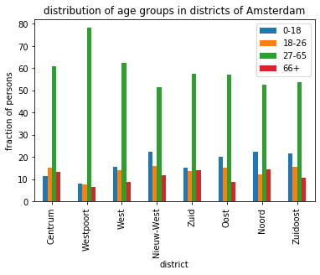
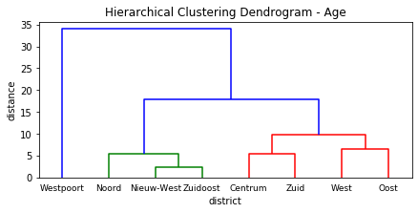
Distribution of age groups
Working
Young families
Mixed

Slide 7
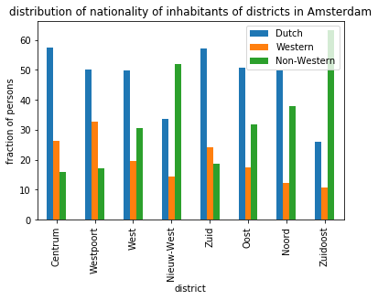
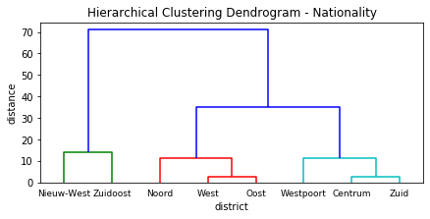
Distribution of nationality/ parentage
Non-Western
Mixed
Dutch/Western

Slide 8
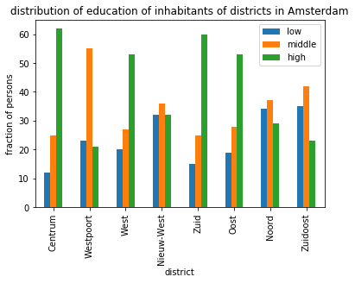
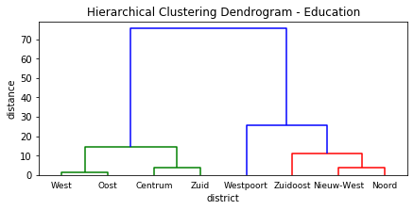
Distribution of education level
High
Middle
Mixed

Slide 9
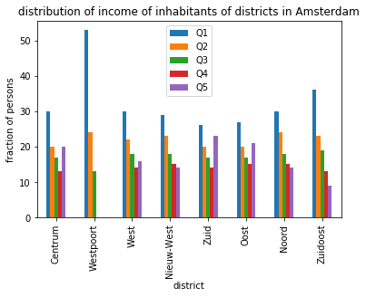
Distribution of income levels
Q4 and Q5 data is missing for Westpoort so clustering is not possible.

Slide 10
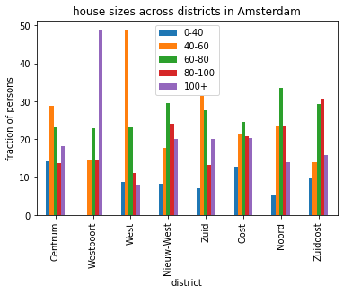
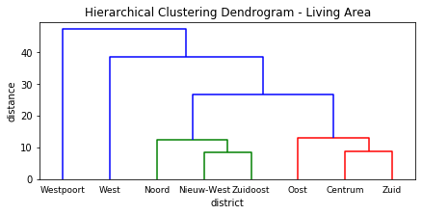
Distribution of house size
Large
Small
Mid-range
Mixed

Slide 11
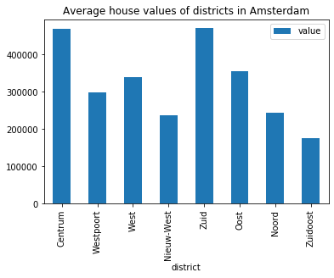
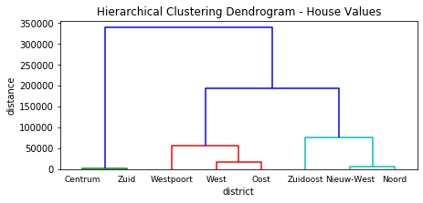
Distribution of average house values
High
Mid-range
Low

Slide 12
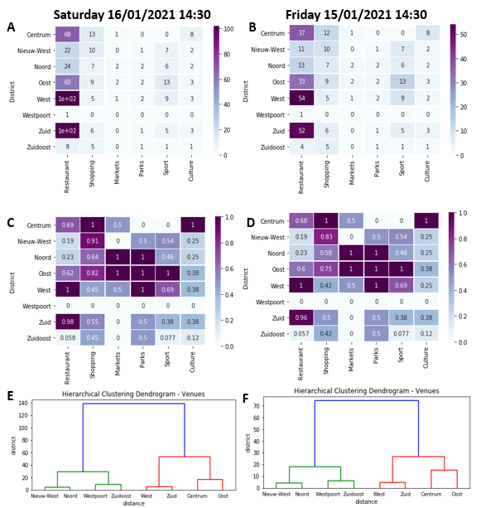
Distribution of venues
Number of venues is dependent on time of query, though no effect on clustering
Clusters:
Few venues
Many venues

Slide 13
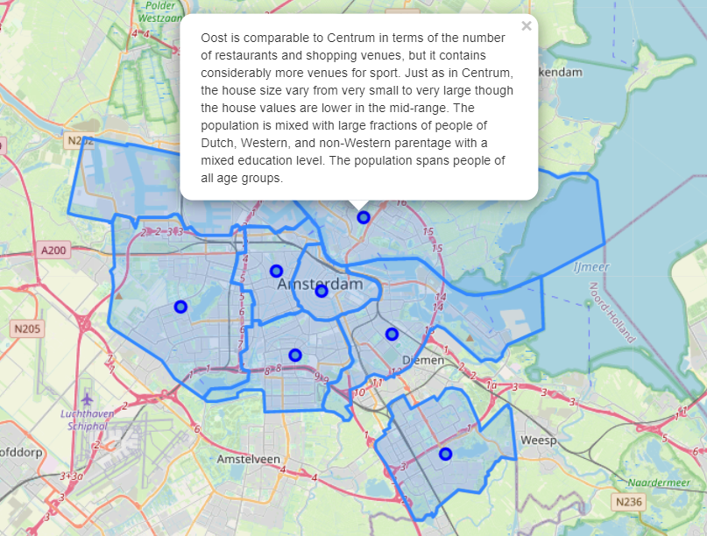
Practical application
Map with districts borders and district centre markers.
Clicking on a marker results in a pop-up with information about the district

Slide 14
Discussion and further directives
District data is suited to provide a general overview of the district, but for more in-depth analysis smaller areas are needed (e.g. neighbourhoods)
Foursquare data changes per query and may not always be representative of actual situation
E.g. overrepresentation markets, underrepresentation shops
Next:
Repeat project with neighbourhood data
Repeat project with more Foursquare data and combine multiple timepoints
Extend project with new categories (e.g. distance to schools, household composition, etc.)

